Slide 1
Detection and Prevention of DDoS Attacks using ML in Cloud Environment
PRESENTED BY:
Achyut Katiyar
Chandra Sai Reddy Donthireddy
Sameer Thadimarri
Krishna Mihir Tatavarthi
Harsha Kothapalli
SUPERVISOR : Dr. Sambit Kumar Mishra

Slide 2
INTRODUCTION
Cloud computing has brought many benefits to businesses, such as cost-effectiveness and scalability. However, it has also introduced new risks and threats to the ecosystem. Here are some of the major threats to cloud networks: One major threat is data breaches. Cloud networks store sensitive and critical data, making them a prime target for hackers. Unauthorized access to cloud networks can lead to data breaches, which can result in identity theft, financial loss, and reputational damage. Malware attacks can infect cloud networks and cause signifi- cant damage to the network and its users. Malware can be used to steal data, spy on users, or launch attacks on other networks.
Account hijacking is another threat to cloud networks. Cloud accounts can be hijacked through phishing attacks or other means, allowing hackers to access sensitive data and resources. Denial of Service (DoS) attacks can disrupt cloud services, rendering them unavailable to users. These attacks can be carried out through a range of methods, including flooding the network with traffic or exploiting vulnerabilities in the network infrastructure.
One of the most significant threats to cloud networks today is Distributed Denial of Service (DDoS) attacks.Cloud service providers employ various techniques such as rate limiting, traffic filtering, and the use of content delivery networks (CDNs) to mitigate the threat of DDoS attacks. However, as DDoS attacks continue to evolve and become more sophisticated, it remains a major threat to the cloud ecosystem.

Slide 3
DATASET
1)Source IP: This attribute represents the IP address of the device that originated the network traffic. An IP address is a unique identifier assigned to each device on a network that uses the Internet Protocol for communication.
2)Source PORT: This attribute represents the port number on the source device that was used for the network traffic. A port number is a 16-bit integer that is used to identify a specific process or service running on a device that is communicating over the internet.
3)Destination IP: This attribute represents the IP address of the device that received the network traffic.
4)Destination PORT: This attribute represents the port num-ber on the destination device that was used for the network traffic.
5)TYPE Protocol: This attribute represents the protocol used for the network traffic, such as TCP (Transmission Con-trol Protocol) or UDP (User Datagram Protocol). A protocol is a set of rules that govern the format and transmission of data over a network.
6)Total Length: This attribute represents the total length of the network traffic packet in bytes. This includes the header information and the payload (data) portion of the packet.
7)Target: This attribute represents the classification target of the network traffic, which could be benign or malicious.

Slide 4
METHODOLOGY
Logistic Regression
Logistic Regression is a popular machine-learning algorithm used for classification tasks. Logistic regres sion models the probability of a binary outcome (e.g., yes/no, true/false) based on one or more input variables. In logistic regression, the output of the dependent variable is a binary variable, which is either 0 or 1.
K-Nearest Neighbour
K-Nearest Neighbors (KNN) is a popular algorithm in ma- chine learning used for classification and regression problems. It is a simple, non-parametric algorithm that can be used for both supervised and unsupervised learning. In KNN, the ”k” refers to the number of nearest neighbours used to classify a new data point.
Naive Bayes
the Naive Bayes algorithm that makes the assumption that the features are normally distributed. This assumption simplifies the calculation of prob- abilities by assuming that the distribution of each feature is independent of the others.

Slide 5
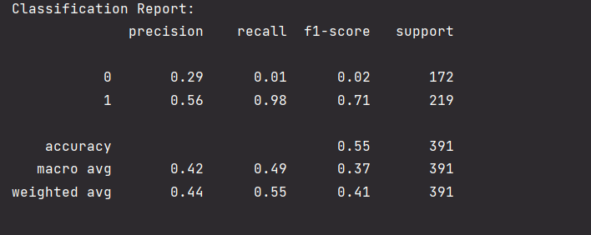
RESULTS
Bayesian model
K-Nearest model
Naive Bayes

Slide 6
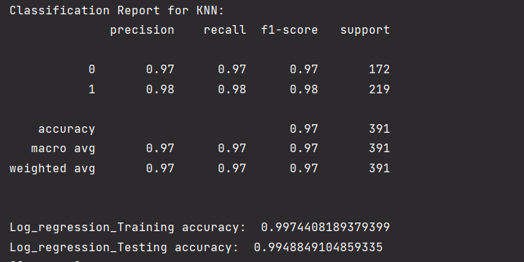
RESULTS
K-Nearest model
KNN

Slide 7
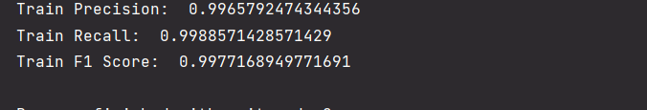
RESULTS
Logistic regression

Slide 8
PREVENTION
IP – BLOCKING
RATE LIMITING

Slide 9
IP BLOCKING
What is IP Blocking?
IP blocking is a method of preventing specific IP addresses from accessing a website or network. It can be implemented in a variety of methods, including firewalls, routers, access control lists, and specialized DDoS protection services. The goal is to identify and block the IP addresses that are generating malicious traffic, such as requests that exceed typical levels, requests with specified patterns or payloads, or requests from known botnets or attackers. This can be done manually or automatically, using either established rules or machine learning techniques.

Slide 10
RATE LIMITING
What is Rate Limiting?
In order to control the volume of incoming traffic, numerous applications, including cloud-based software, use a mechanism called rate limiting. It serves as a safeguard against overtaxing a system or network by limiting the quantity of requests thatmay be handled at one time. Rate limiting’s major goal is to keep a system or network from becoming overloaded with too many requests, thereby ensuring that it is still functional and accessible to authorised users.

Slide 11
CONCLUSION
Due to the increasing frequency and sophistication of cyber threats, it is now more crucial than ever to detect and block DDoS attacks using machine learning (ML) in a cloud context. Security teams can swiftly detect and neutralise DDoS assaults before they do substantial harm because to the ability of ML algorithms to analyse vast volumes of data in real-time and discover aberrant patterns and behaviours.
Due to the scalability and flexibility of cloud services, ML- based DDoS detection and prevention can be very useful in a cloud setting. Cloud-based ML solutions can swiftly react to changing attack patterns and reduce the effects of DDoS attacks thanks to their capacity to instantly spin up extra resources and intelligently disperse traffic over many servers. However, the quality of the data and the precision of the algorithms are what determine how well ML-based DDoS detection and prevention works. To ensure that ML models are optimised for the unique features of the cloud environment, it is crucial to regularly monitor and improve them.

Slide 12


